Slide 1
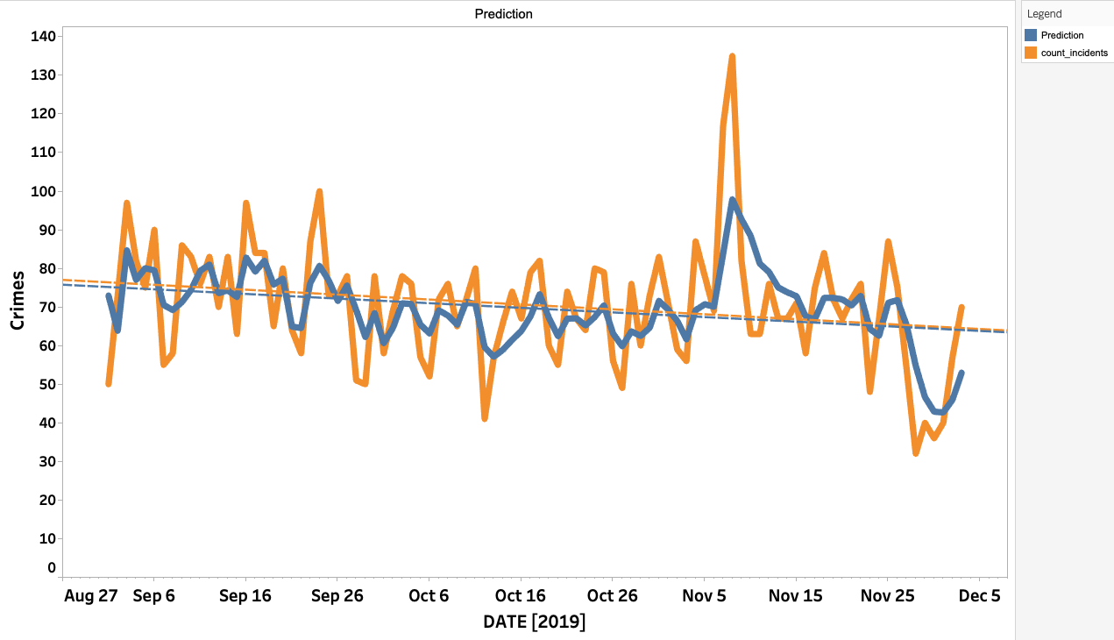
PREDICTION - FORECAST VS ACTUAL CRIME

Slide 2
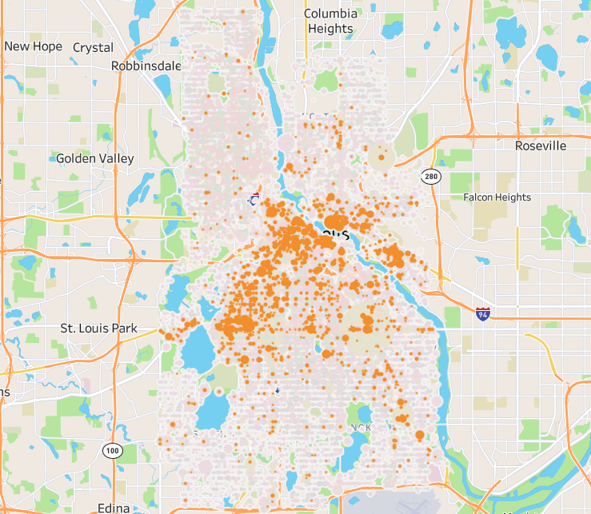
STOLEN BIKES

Slide 3
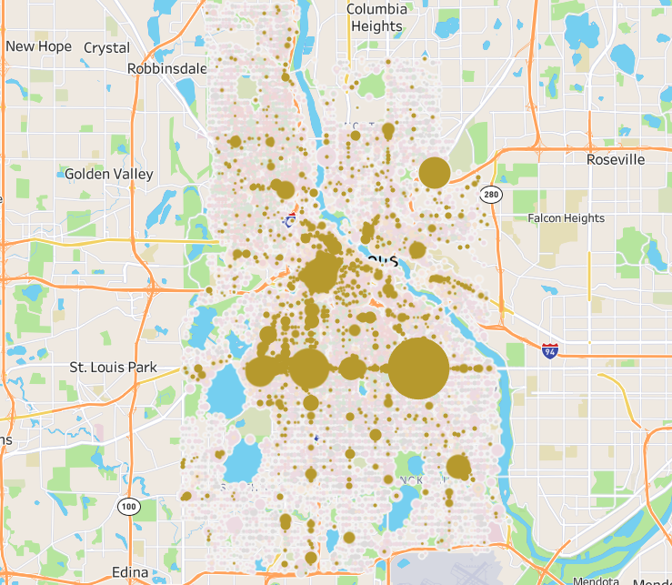
THEFTS FROM BUSINESS

Slide 4
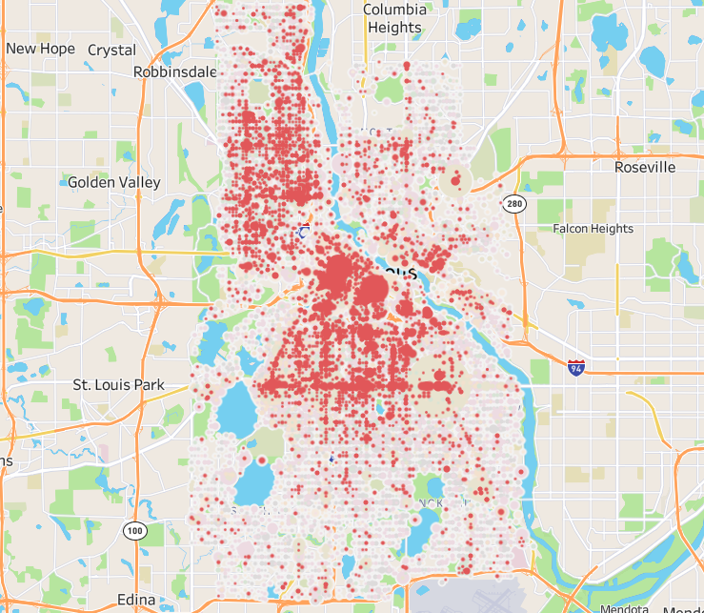
ASSAULT, THEFT FROM PERSON

Slide 5
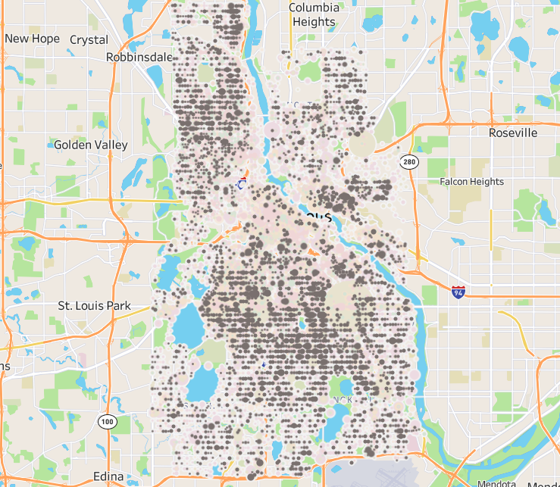
THEFT FROM HOME

Slide 6
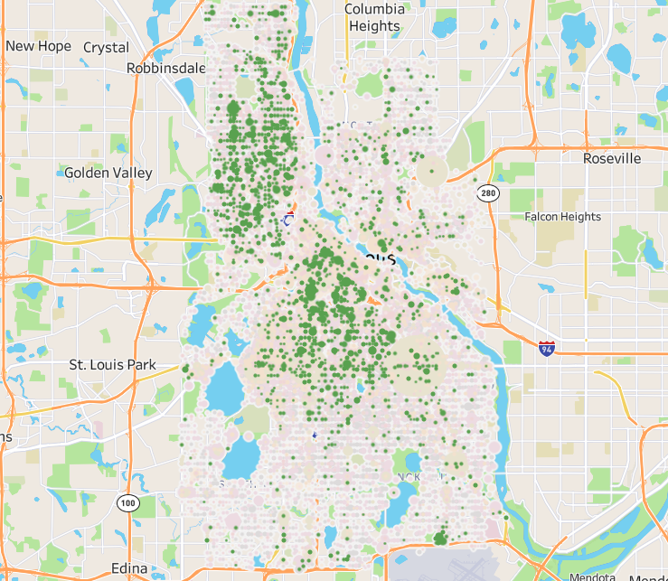
SEXUAL/DOMESTIC

Slide 7
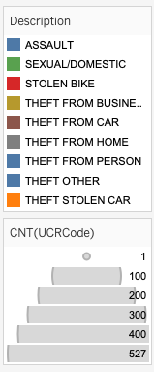
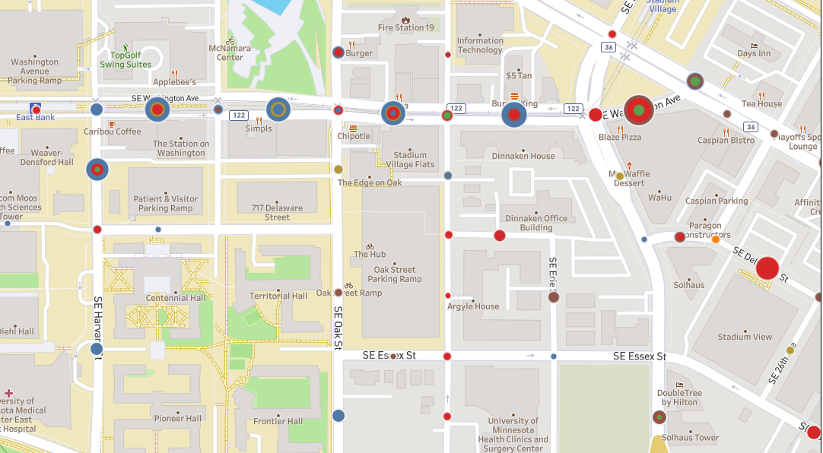
Crimes near East Bank (Wahu, other student residence communities)

Slide 8
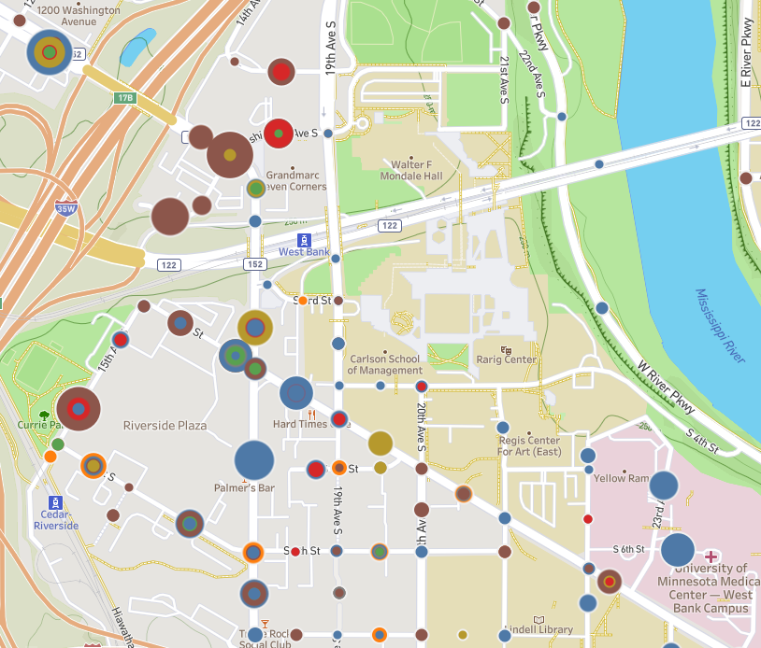
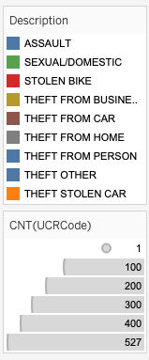
CRIME NEAR CARLSON

Slide 9
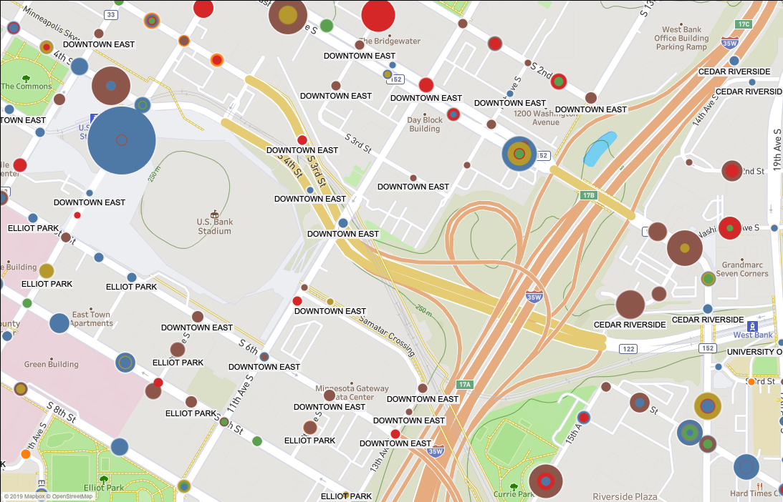
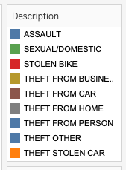
US BANK STADIUM

Slide 10
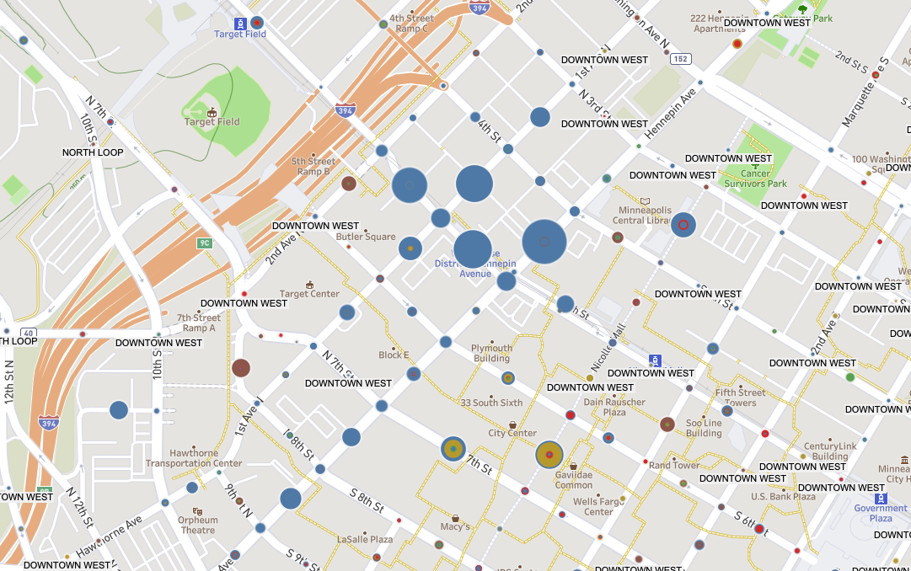
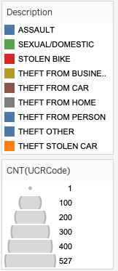
HENNEPIN & FIRST AVE LIGHT RAIL STATIONS

Slide 11
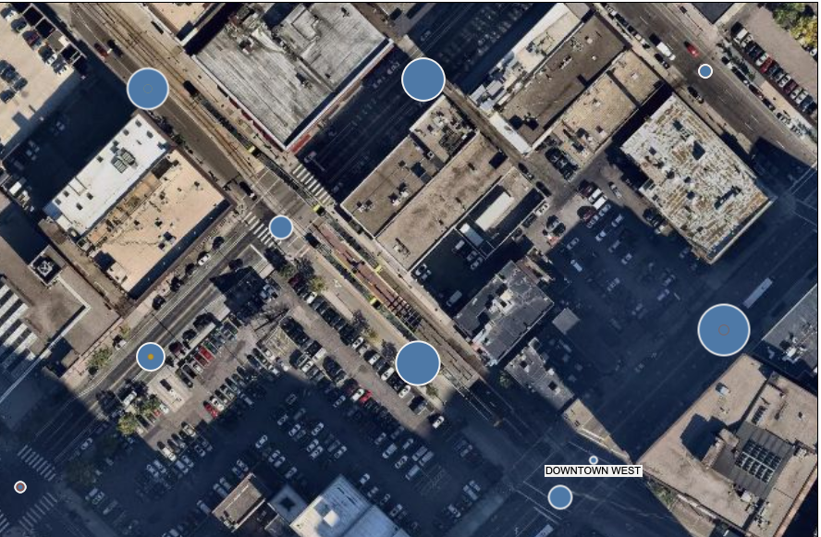
SATELLITE VIEW OF HENNEPIN & FIRST AVE RAIL STATIONS

Slide 12
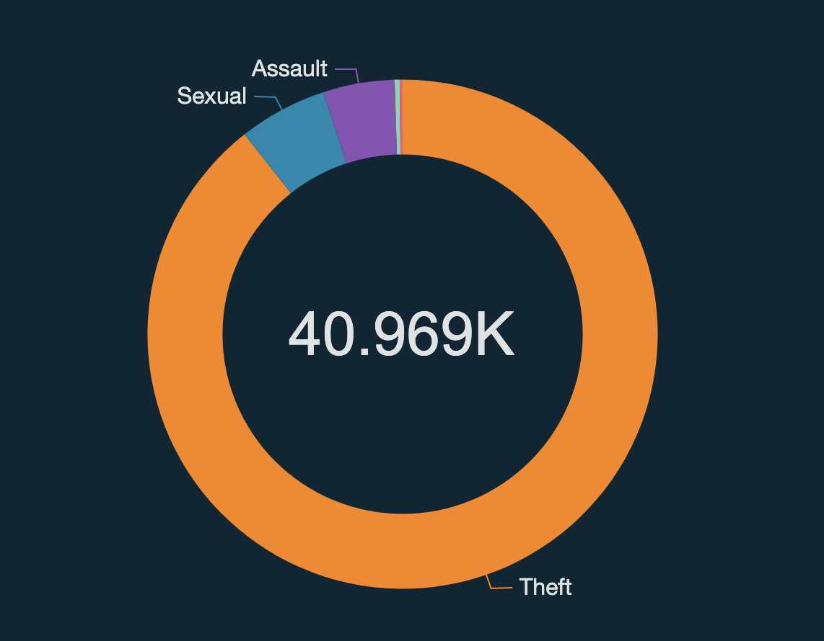
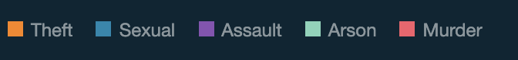
TOTAL CRIMES IN 2019

Slide 13
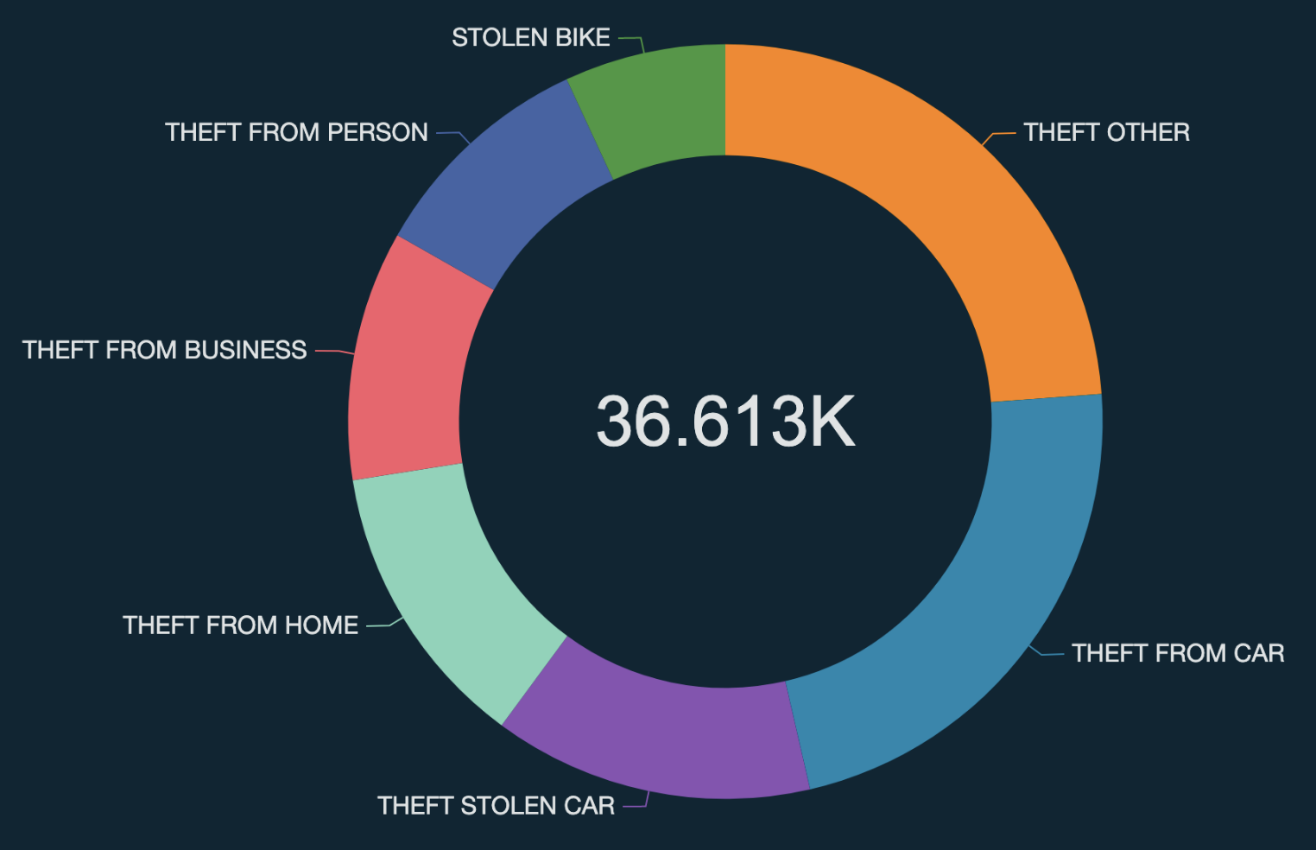
TOTAL THEFT BY TYPE IN 2019

Slide 14
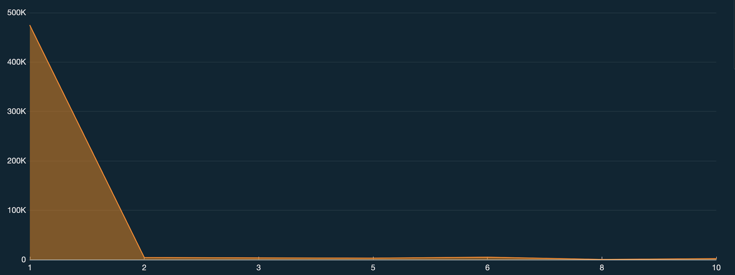
CRIME WHEN IT’S SNOWING
SNOWFALL IN INCHES

Slide 15
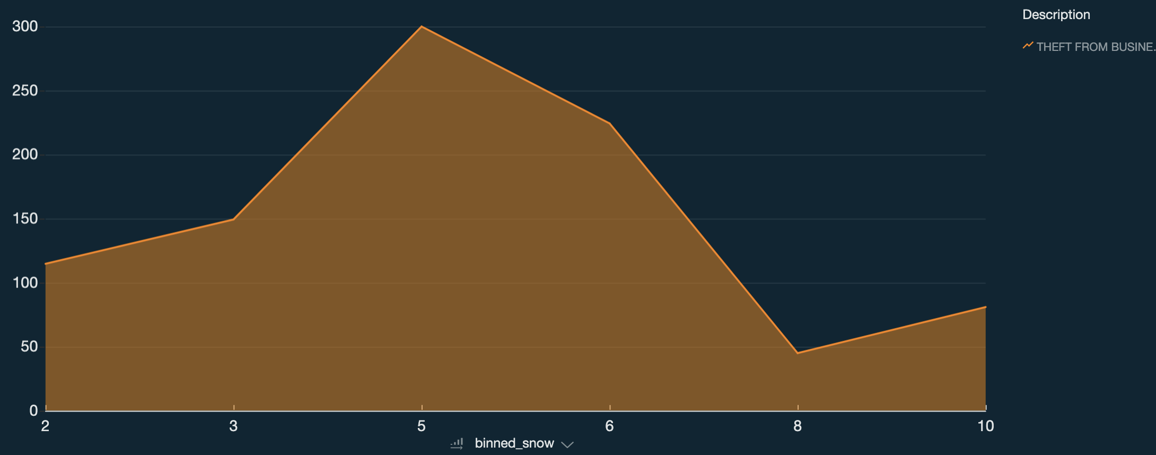
BUSINESS THEFT WHEN SNOWING
SNOWFALL IN INCHES

Slide 16
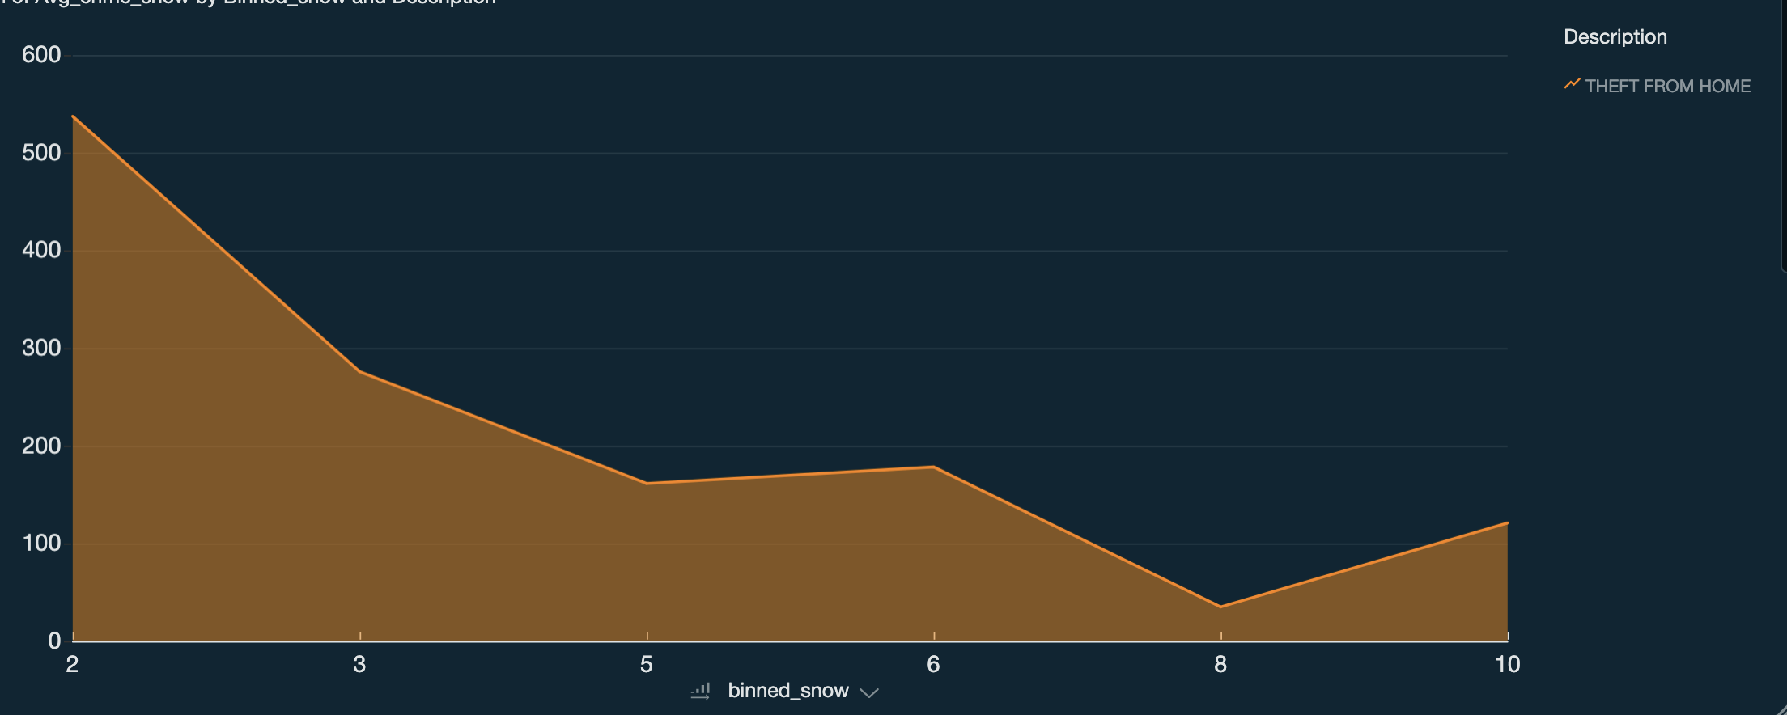
HOME THEFT WHEN IT’S SNOWING
SNOWFALL IN INCHES

Slide 17
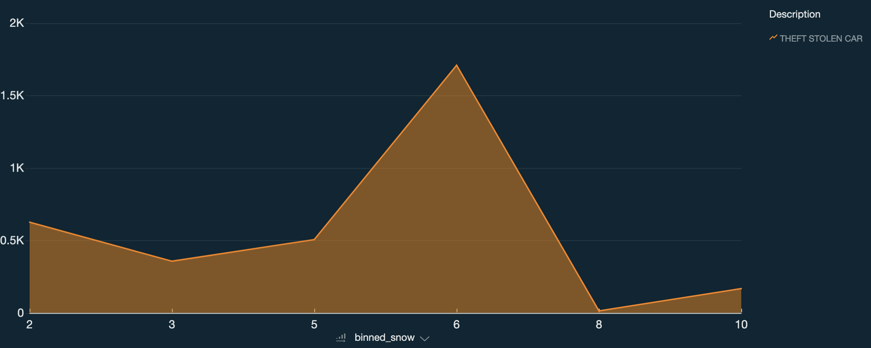
CAR THEFT WHEN IT’S SNOWING
SNOWFALL IN INCHES

Slide 18
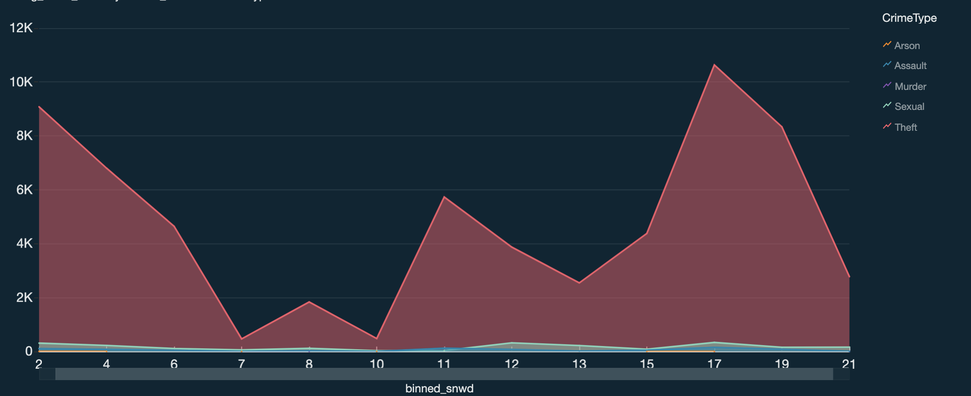
DEPTH OF SNOW IMPACT ON CRIME BY TYPE
INCHES OF SNOW ON THE GROUND
Notes:
Mpls is good at clearing snow? People not so much at their homes?

Slide 19
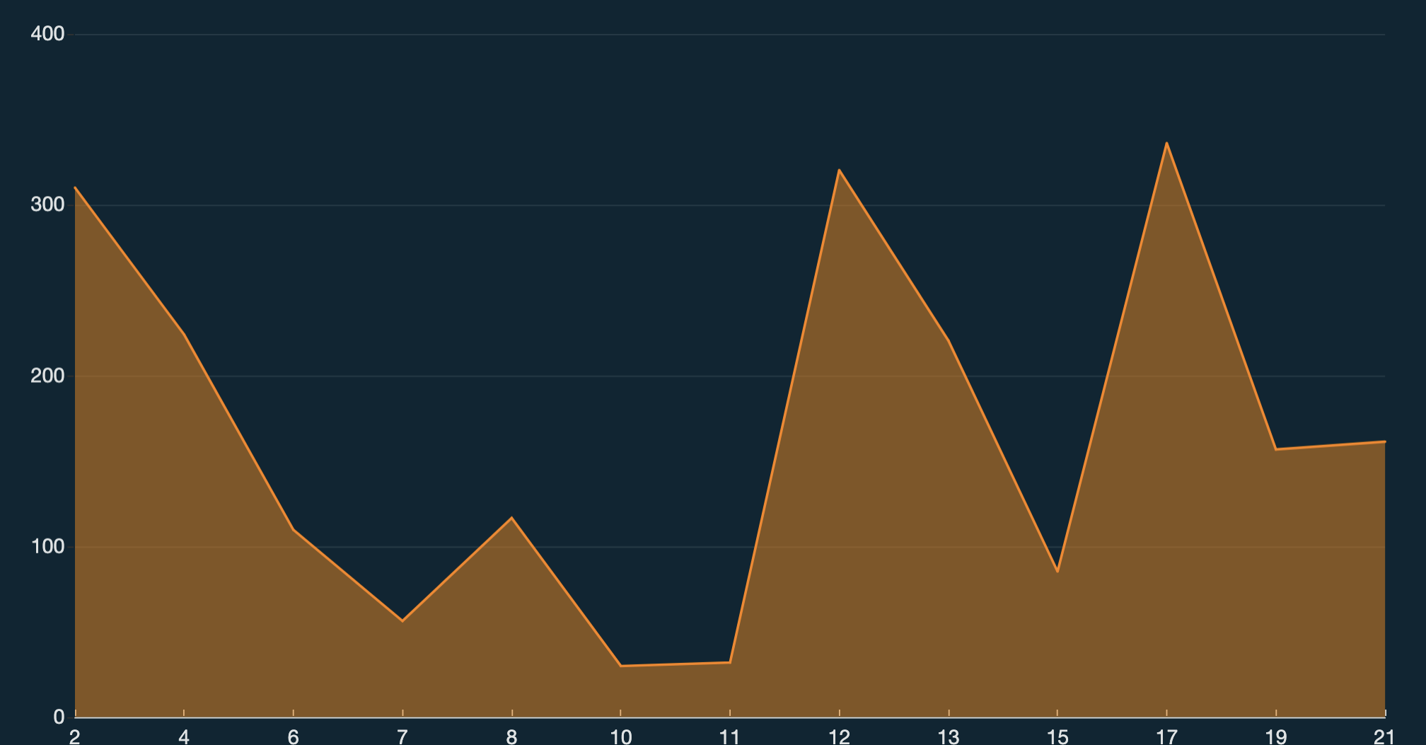
DEPTH OF SNOW IMPACT ON DOMESTIC DISTURBANCE
INCHES OF SNOW ON THE GROUND

Slide 20
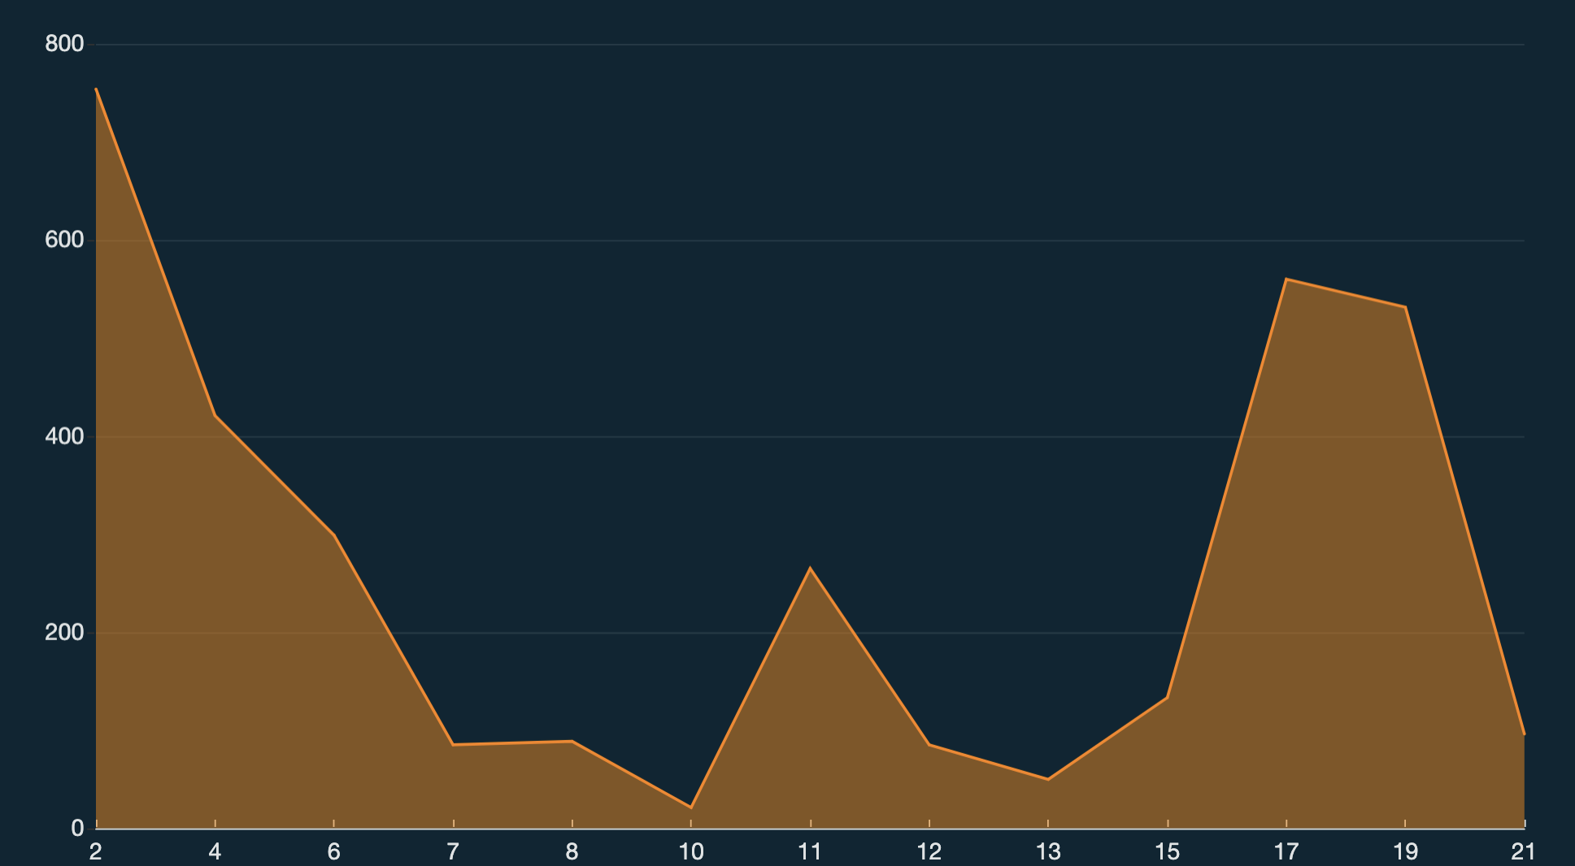
DEPTH OF SNOW IMPACT ON HOME THEFT
INCHES OF SNOW ON THE GROUND
Notes:
can tell when no one is home

Slide 21
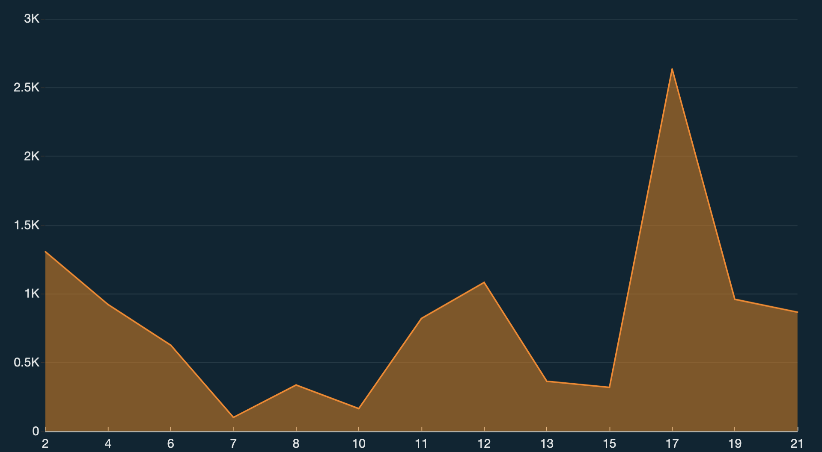
DEPTH OF SNOW IMPACT ON CAR THEFT
INCHES OF SNOW ON THE GROUND

Slide 22
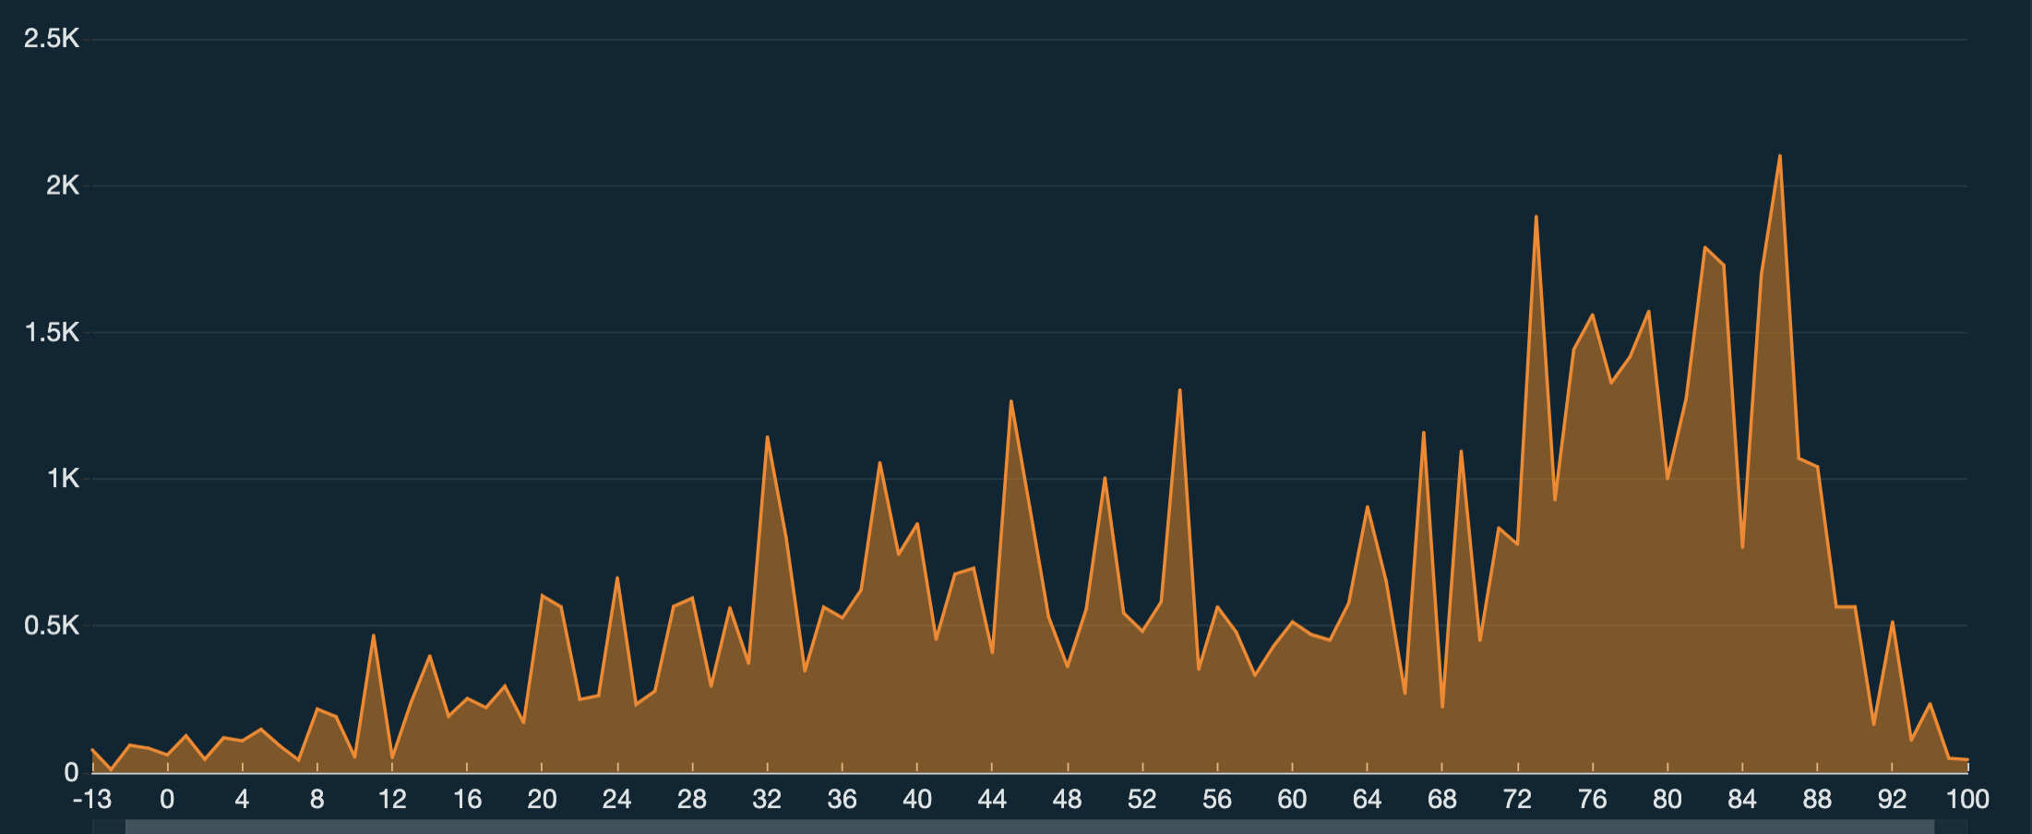
MAX TEMPERATURE IMPACT ON CRIME
MAX TEMP

Slide 23
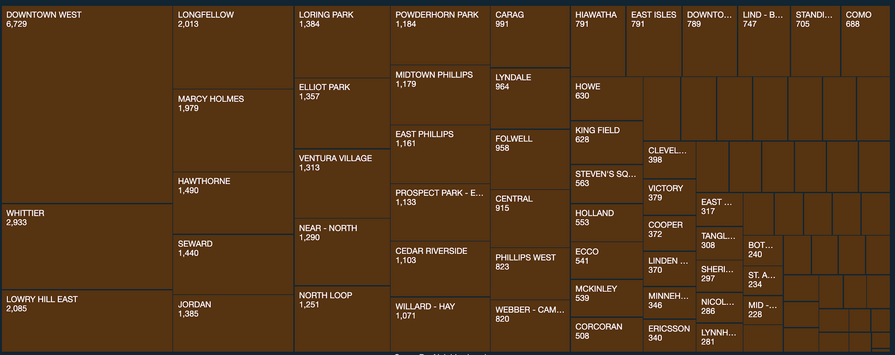
CRIME COUNT BY NEIGHBORHOOD

Slide 24
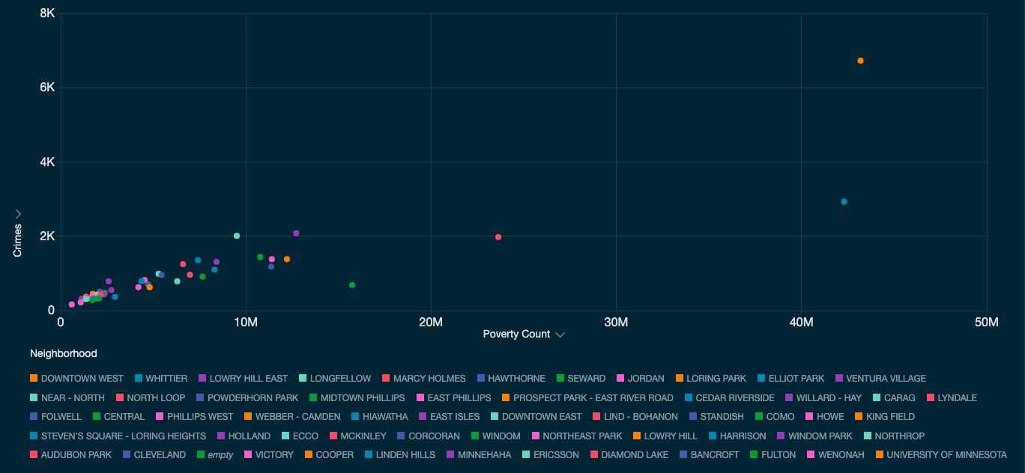
CRIME COUNT COMPARED TO POVERTY LEVEL

Slide 25
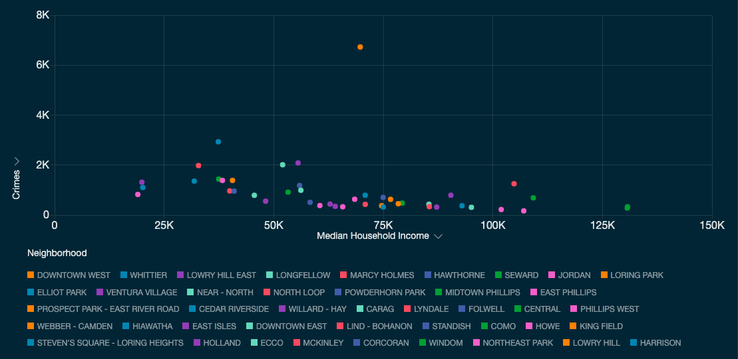
CRIME COUNT COMPARED WITH MEDIAN HOUSEHOLD INCOME

Slide 26
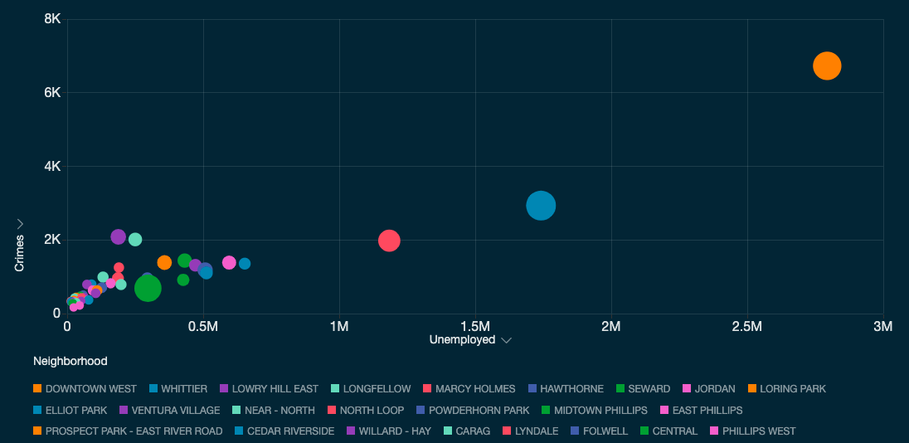
CRIME COMPARED WITH UNEMPLOYMENT ^{(BUBBLE SIZE = Total People)}

Slide 27
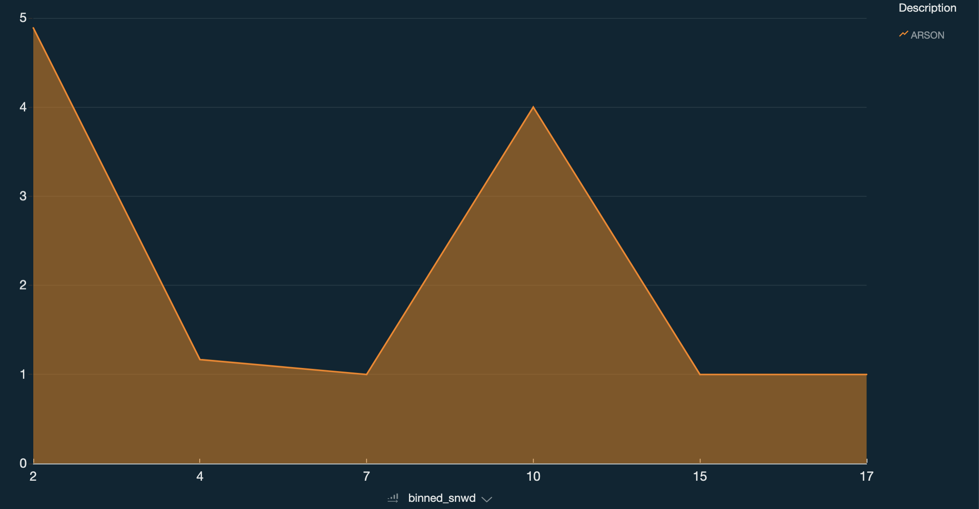
Snow Depth impact excluding 0-1 bucket .. small nuanced

Slide 28
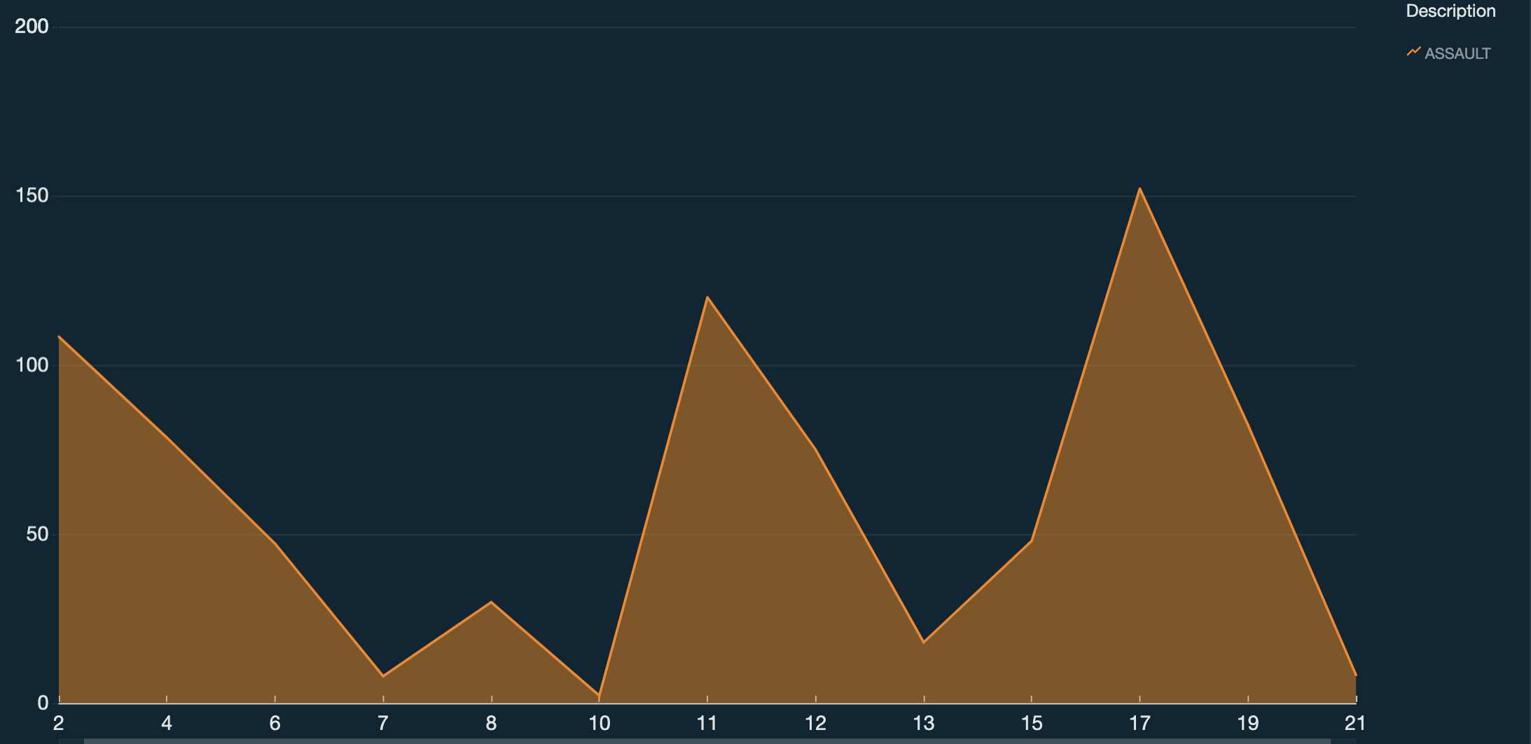
DEPTH OF SNOW IMPACT ON ASSAULT…
Notes:
SIMILAR TO DOMESTIC, but domestic is more interesting.

Slide 29
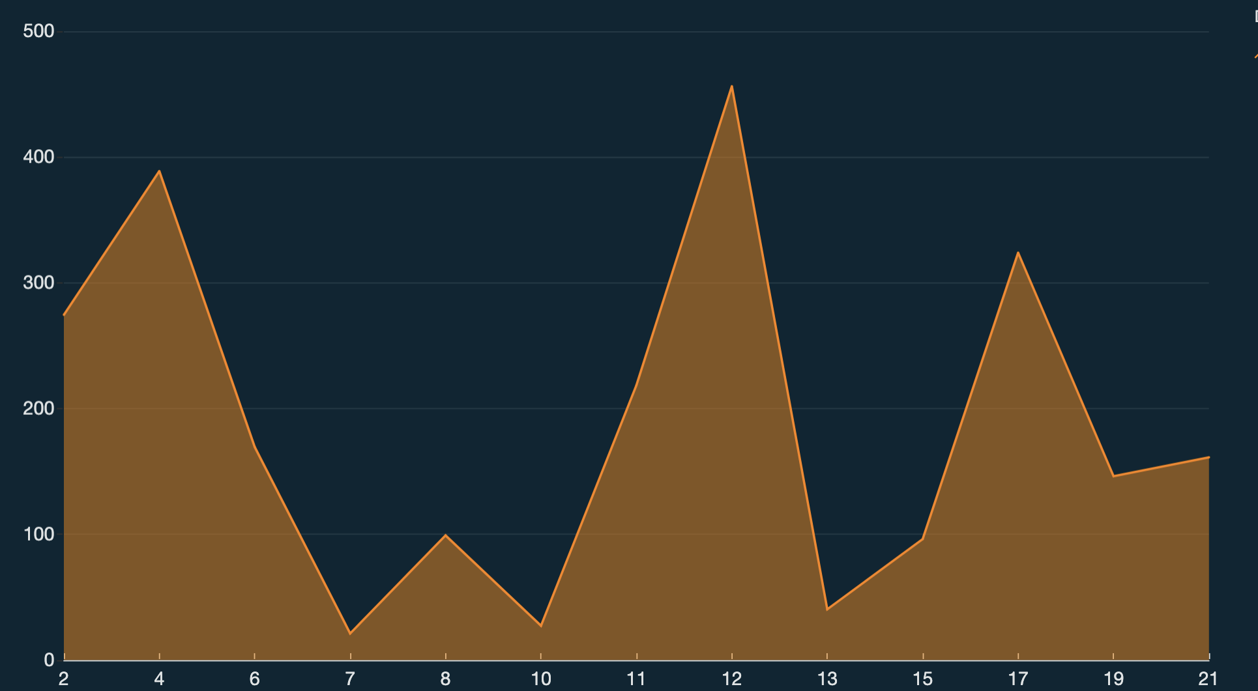
DEPTH OF SNOW IMPACT ON PERSONAL THEFT
Notes:
No story here, except maybe that minneapolis is good at cleaning up snow and clearing streets. Not specific to our predictions...

Slide 31
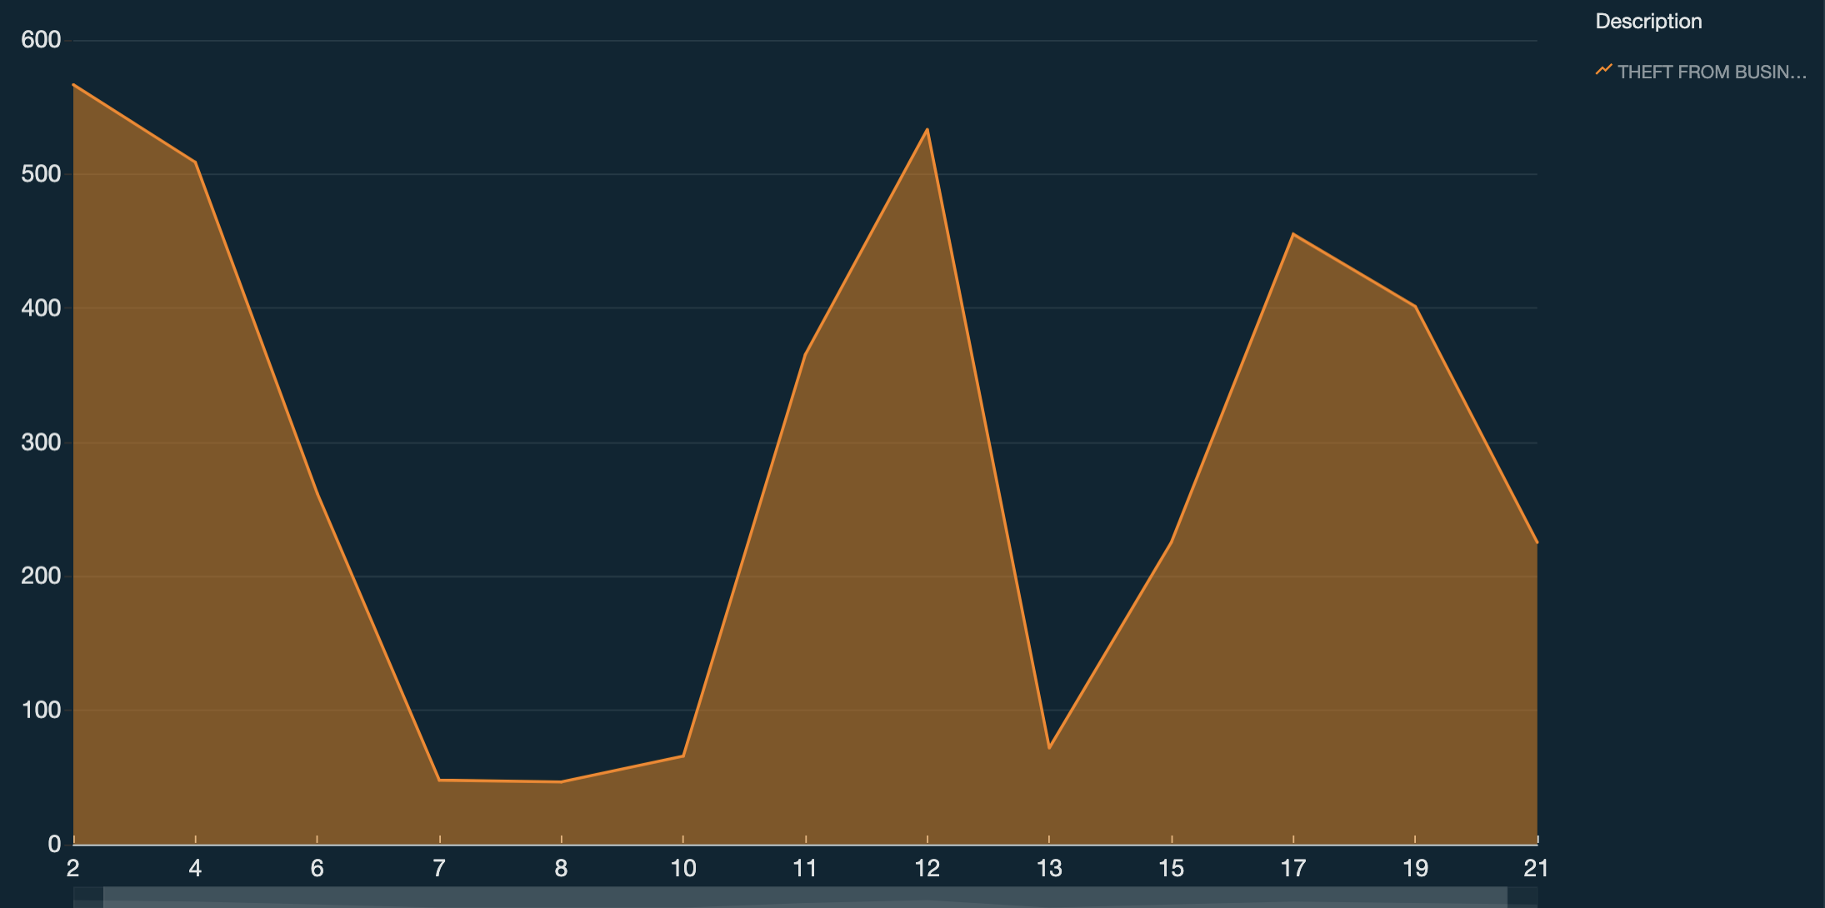
DEPTH OF SNOW IMPACT ON BUSINESS THEFT.. use personal to show all over
Notes:
USE personal theft to show all over the place

Slide 32
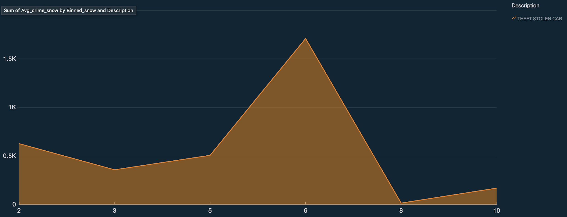
CAR THEFT WHEN IT’S SNOWING … duplicate
SNOWFALL IN INCHES

Slide 33
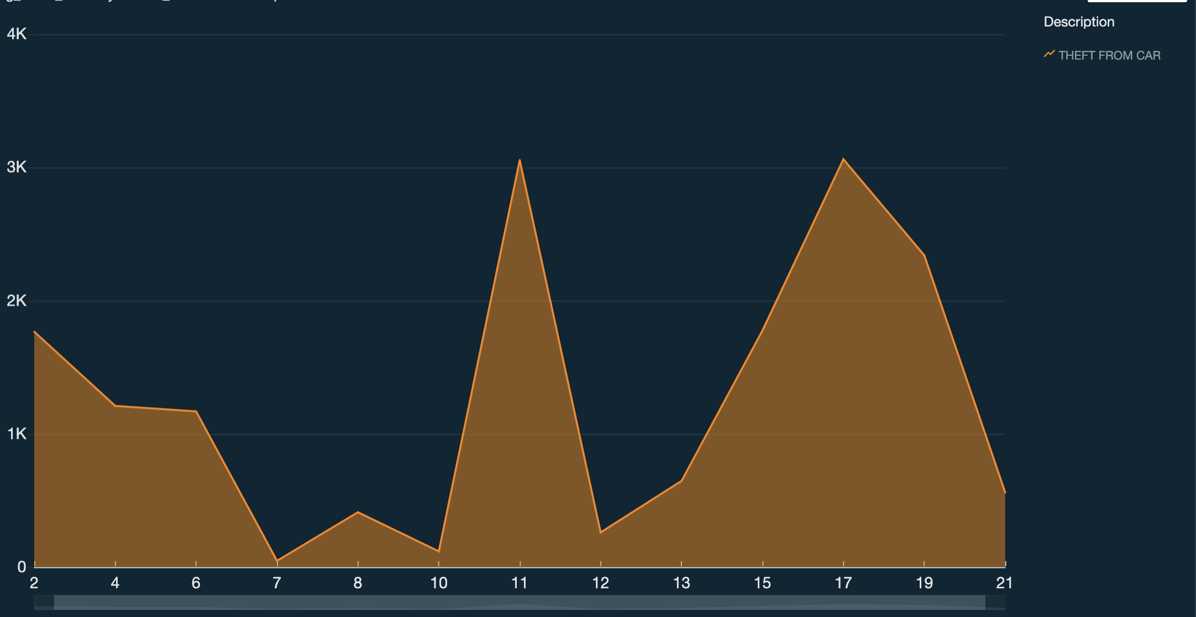
DEPTH OF SNOW IMPACT ON CAR THEFT… from car similar to stolen car

Slide 34
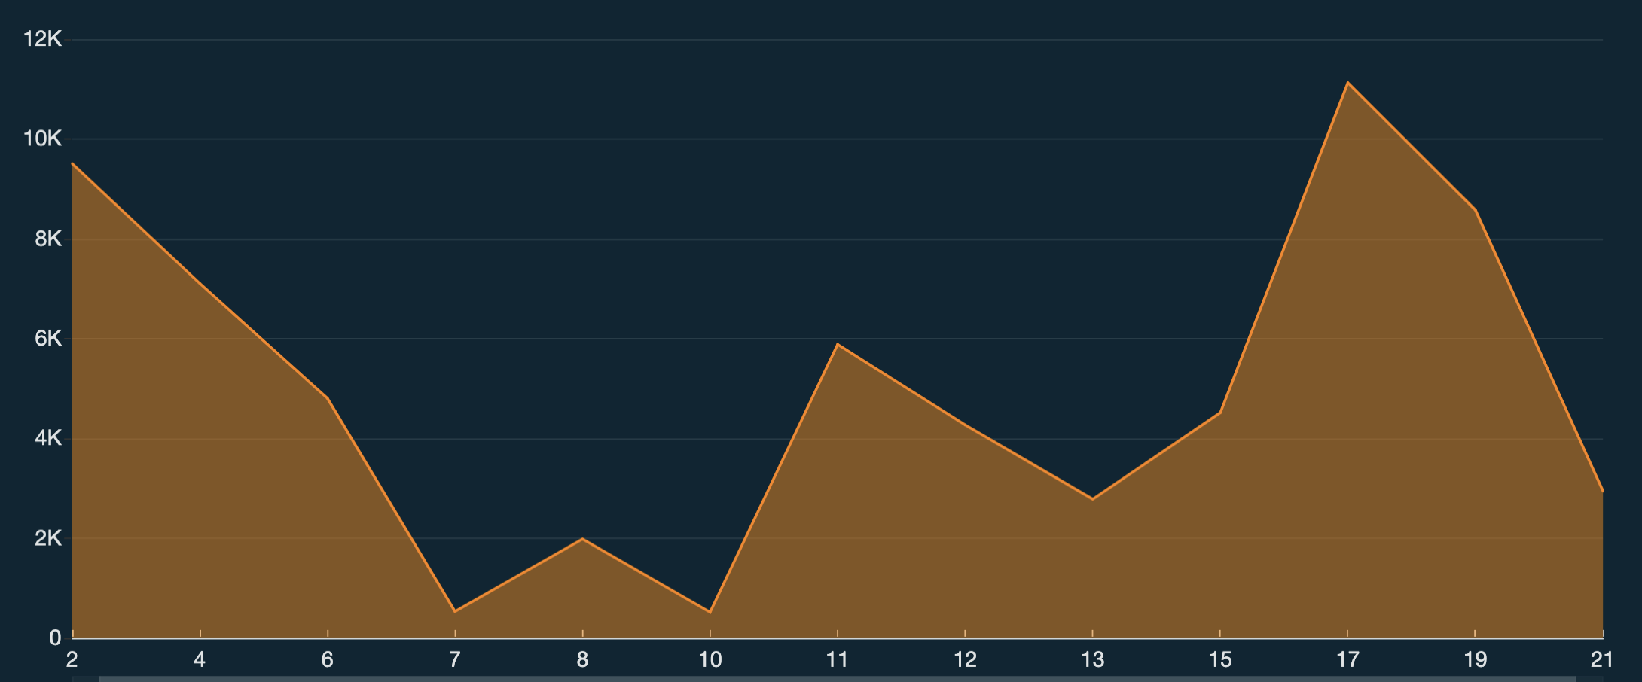
Snow Depth impact excluding 0-1 bucket… theft only? have by type

Slide 35
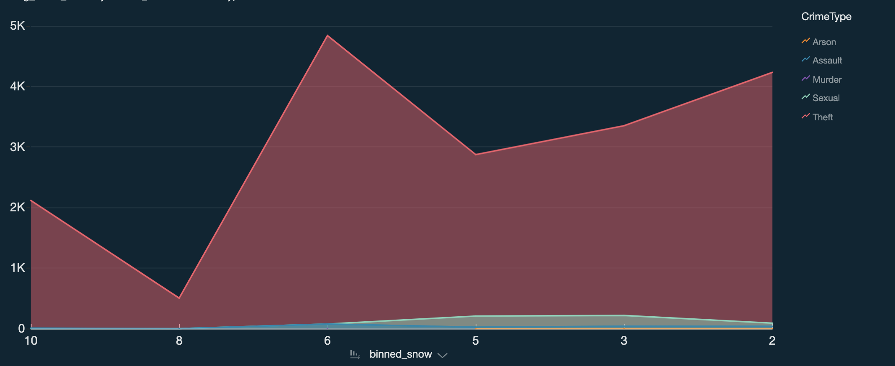
Snow impact excluding 0-1 bucket
By crime type

Slide 36
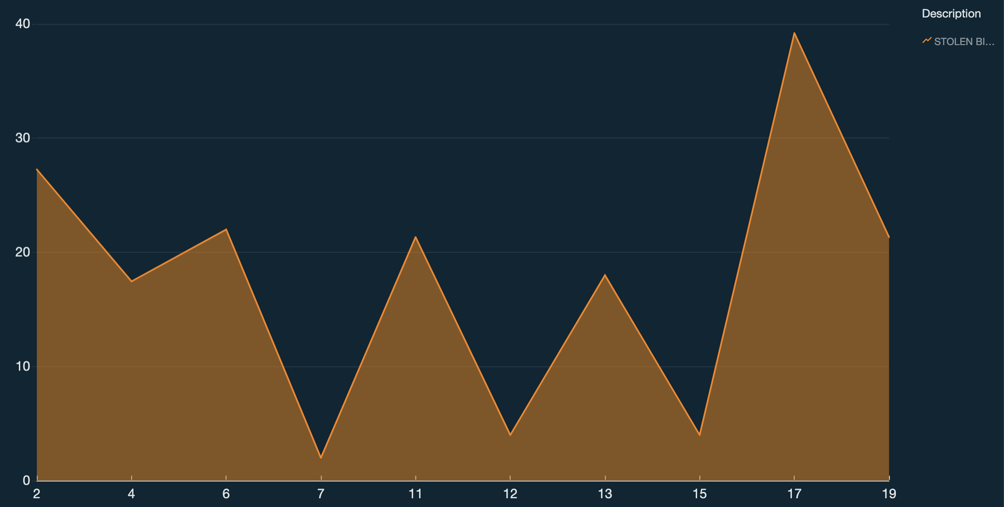
DEPTH OF SNOW IMPACT ON STOLEN BIKES

Slide 37
Snow impact excluding 0-1 bucket

Slide 38
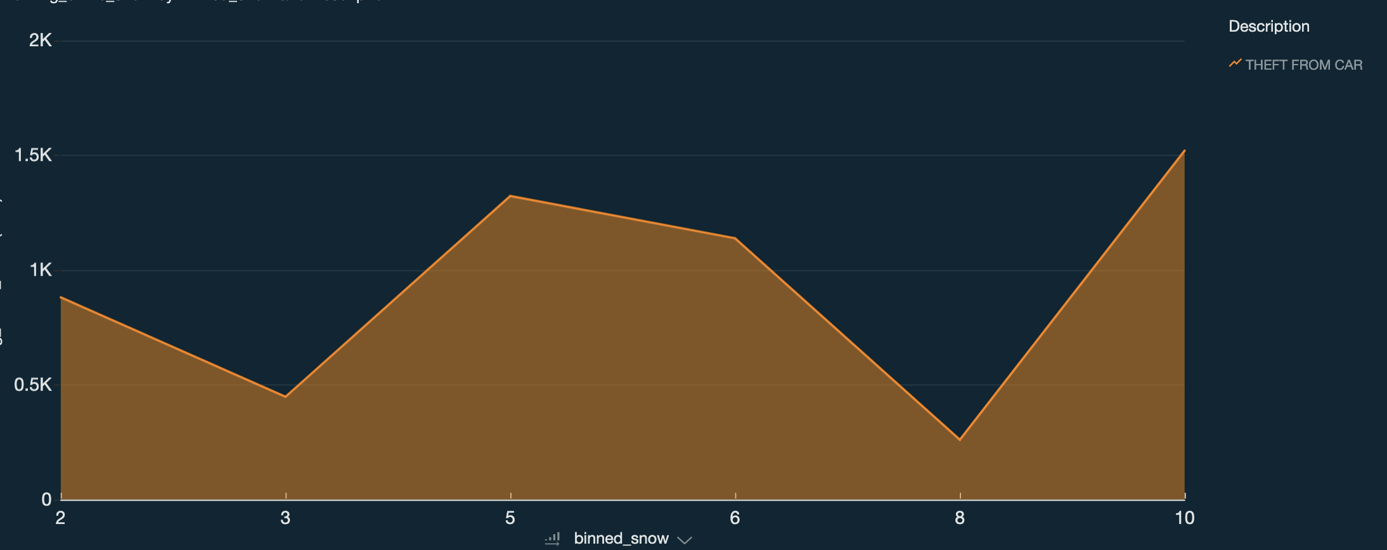
Snow impact excluding 0-1 bucket

Slide 39
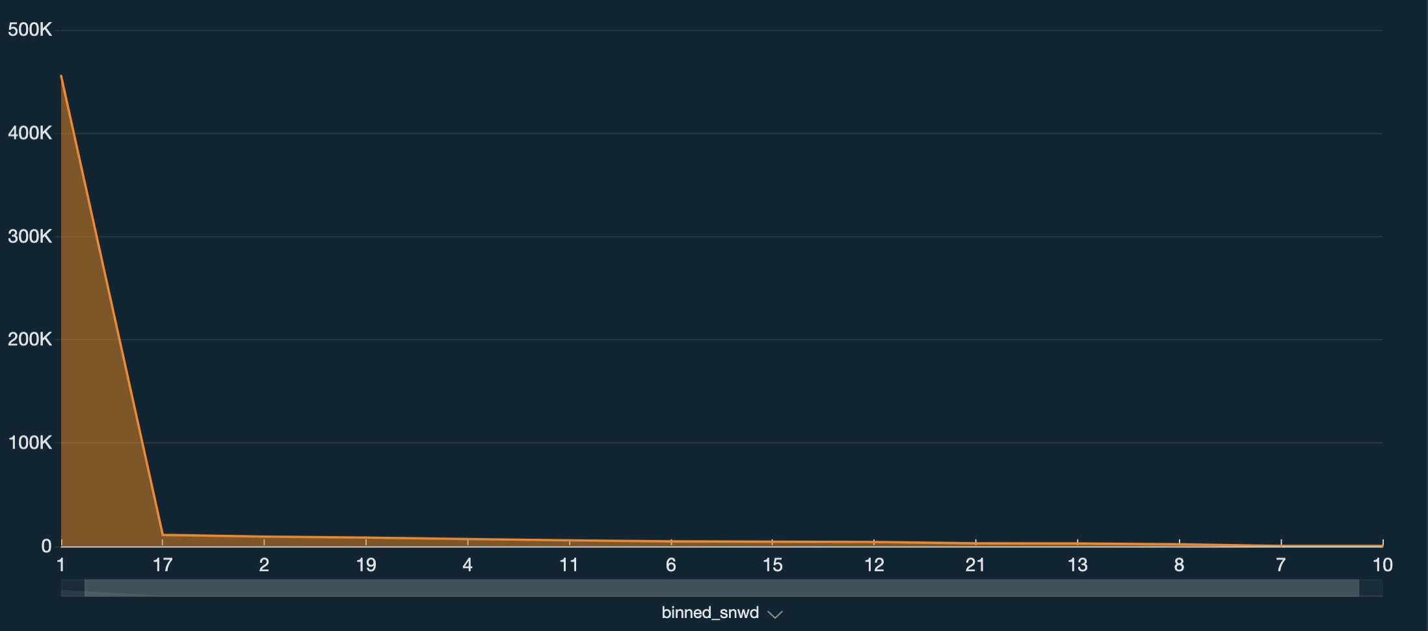
Snow Depth impact

Slide 40
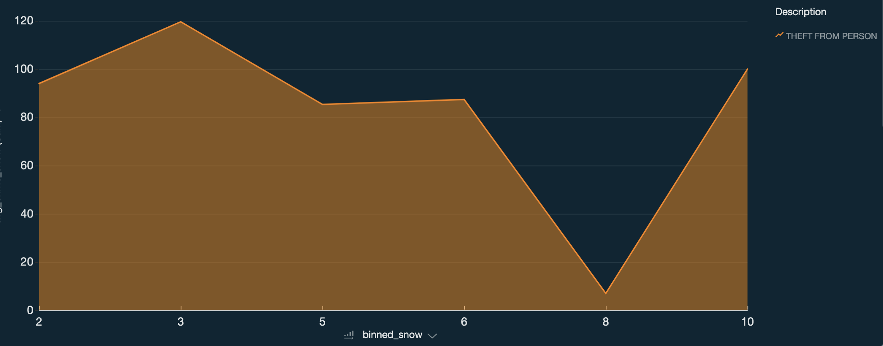
PERSONAL THEFT WHEN IT’S SNOWING

Slide 41
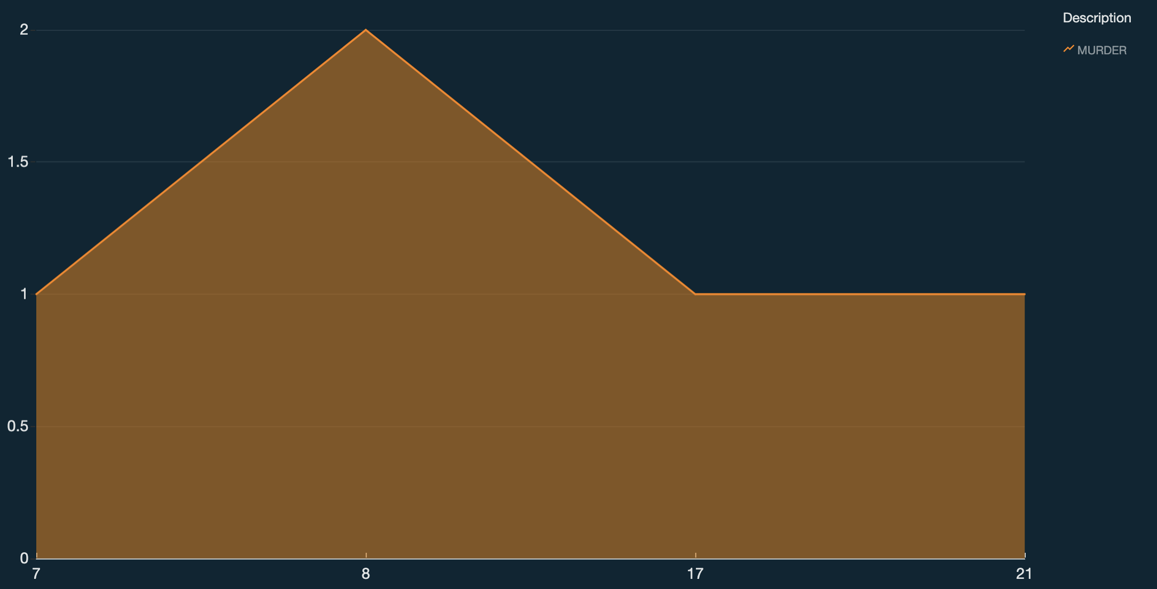
MURDER COUNT BY SNOW DEPTH

Slide 42
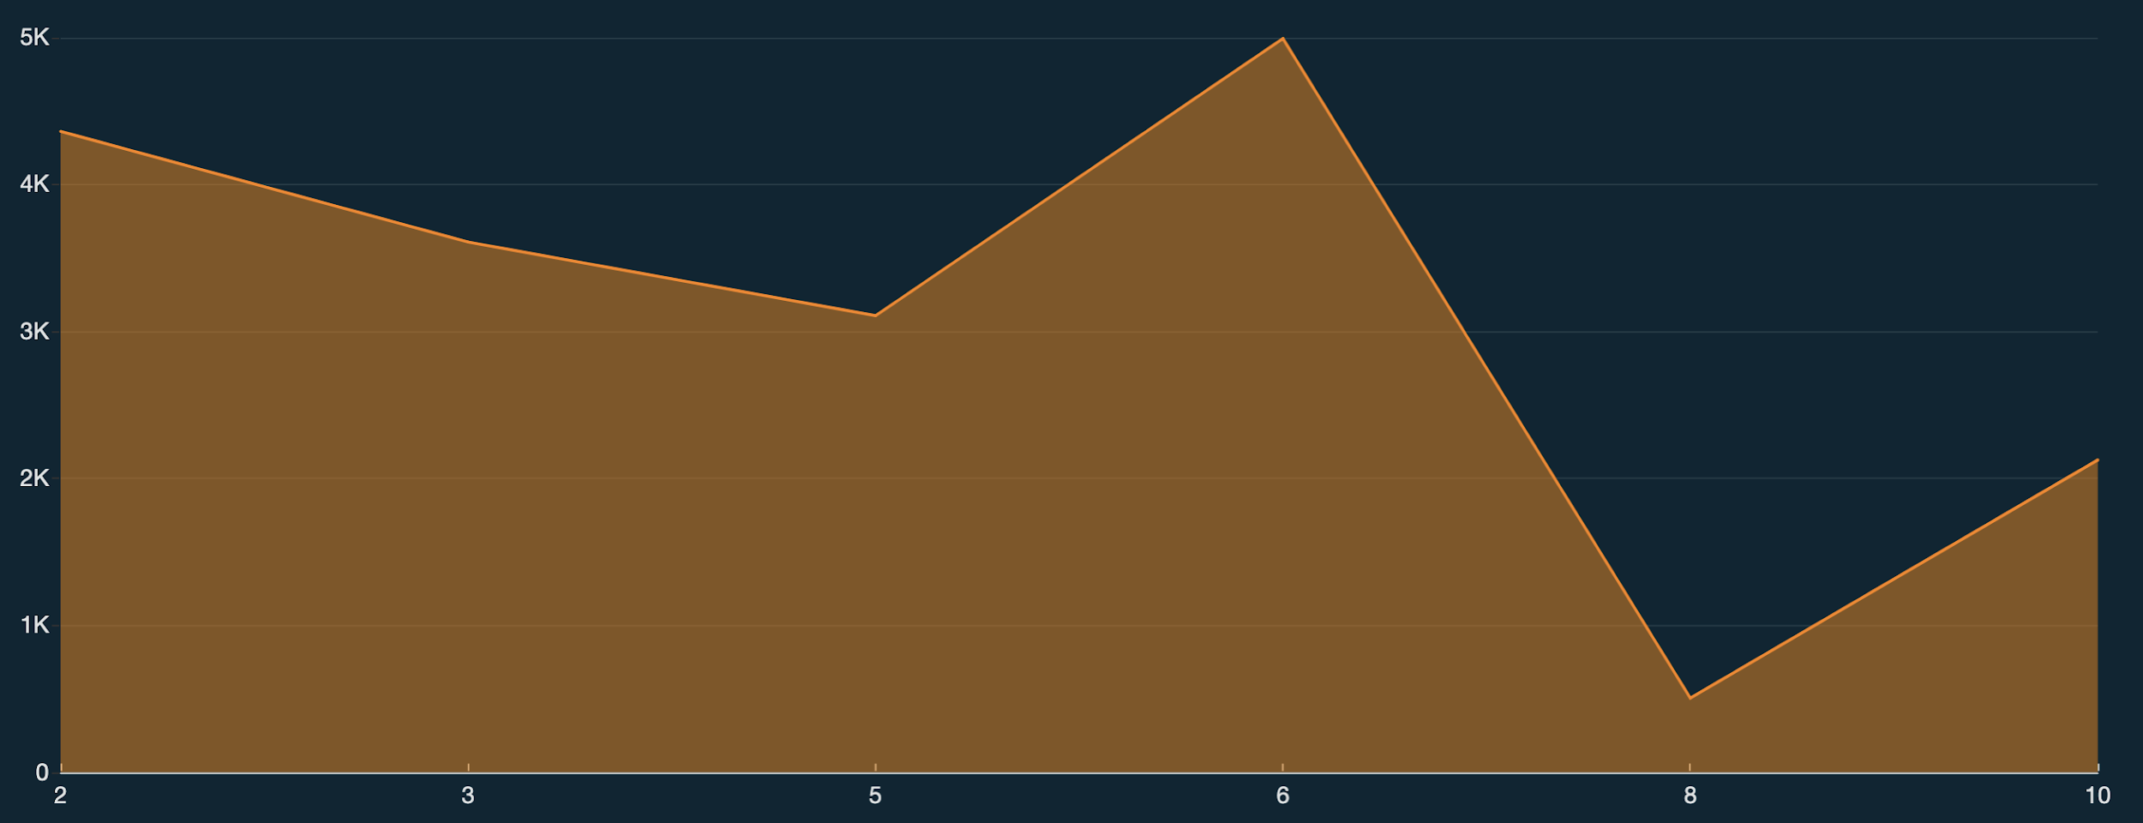
Snow impact excluding 0-1 bucket .. don’t know what this is…

Slide 43
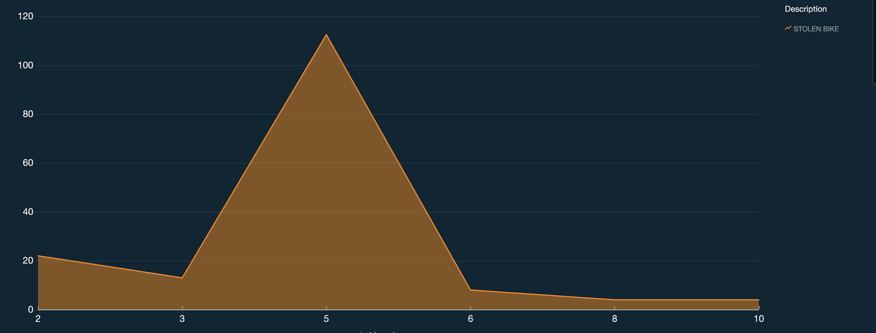
Snow impact excluding 0-1 bucket … really small

